Slide 1
Los verbos reflexivos
Llamarse, Lavarse, Levantarse, Irse, Llevarse, Peinarse

Slide 2
Definition and usage
A verb is reflexive when the subject and the object are the same.
I wash myself. Yo me lavo.
But, I wash the car. Yo lavo el coche.
This is not reflexive because subject and object are not same.
When a verb is reflexive, the infinitive ends in "se.“
Llamarse, Lavarse, Levantarse, Llevarse, Peinarse etc

Slide 3
There is one reflexive verb we have been using since we began studying Spanish.
llamarse - to call oneself
¿Cómo se llama usted? What is you name?
Me llamo Juan. My name is Juan/ I am called Juan

Slide 4
Reflexive Pronouns
Lavarse
Yo me
Tu te
El/ella/ustedes Se
Nosotros/-as Nos
Vosotros/-as Os
Ellos/Ellas/Ustedes Se
Llamarse
Yo me llamo
Tu te llamas
El/ella/ud. se llama
Nosotros/-as nos llamamos
Vosotros/-as os llamáis
Ellos/Ellas/uds. se llaman

Slide 5
Reflesive pronoun
The purpose of the reflexive pronouns is to show that the action of the verb remains with the subject.
Juan se lava la cara.
Juan washes his face. (reflexive)
Juan lava su carro. (non-reflexive)
Juan washes his car.
Note: When referring to body parts, use the definite article, thus "la cara" not "su cara."

Slide 6
Regular reflexive verbs
Levantarse: to wake up
Lavarse: to wash oneself
Cepillarse: to brush
Afeitarse: to shave
Bañarse: to take bath/ Ducharse: to take shower
Peinarse: to comb
Maquillarse: put on make up

Slide 7
Irregular reflexive verbs
Despertarse: to wake up
Acostarse: to go to bed
Dormirse: To sleep off
Vestirse: to dress up

Slide 8
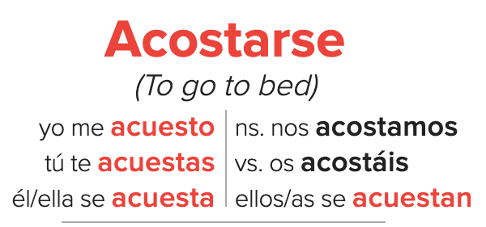


Slide 9
Dormirse (to sleep off/ to fall asleep)
Yo me duermo (I fall asleep)
Tú te duermes (You fall asleep)
Él/Ella/Usted se duerme (He/She/You fall asleep)
Nosotros/Nosotras nos dormimos (We fall asleep)
Vosotros/Vosotras os dormís (You all fall asleep)
Ellos/Ellas/Ustedes se duermen (They/You all fall asleep)

Slide 10

Vestirse (dress up)
Notes:
vestirse conjugation - Search Images (bing.com)

